Slide 1
Nepal Flood & Weather Analysis
Next‑Day River Discharge and Weather Prediction
Machine learning for river monitoring and flood-risk assessment
Linear and Logistic Regression · Decision Tree · Random Forest

Slide 2
The dataset: 10 stations, daily records
13,390
10
19
0
daily records
river stations
raw columns
missing values or duplicates
Objective
Predict next-day river discharge (m³/s) and next-day weather class (Cold, Cool, Warm or Hot) at each station from weather, soil moisture, and recent rainfall and flow history. Stations span the Narayani and Koshi basins, among others.

Slide 3
Project workflow : Next day river discharge
1
2
3
4
5
Explore
Engineer
Split
Train
Evaluate
Distributions, seasonality and correlations
Rain lags, rolling rain, calendar features
Earliest 80% of dates train, latest 20% test
Linear Regression, Decision Tree, Random Forest
MAE, RMSE and R² against a baseline
Target: next_day_discharge, the next day's discharge shifted within each station

Slide 4
Discharge is extremely skewed
Mean discharge by station (m³/s)
1.88
median m³/s
20.4
mean m³/s
3,176
max m³/s
Kusum alone averages 4× the next station. Discharge is log-transformed for plotting.

Slide 5
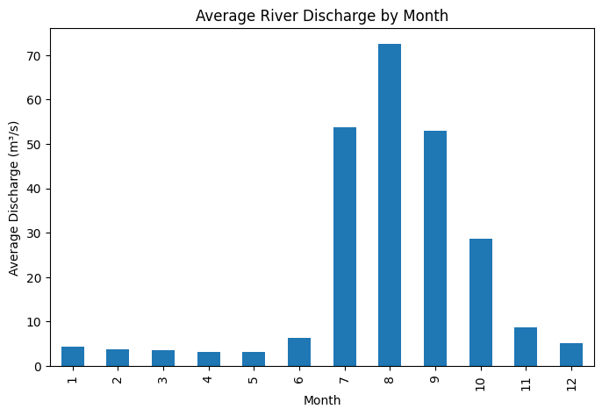
The monsoon drives the flow
July to September carry the highest flows; August averages about 73 m³/s.
December to May stay near 3 to 5 m³/s.
All of the 10 largest readings are at Kusum, peaking at 3,175.87 m³/s on 28 Sep 2024.

Slide 6
Same-day weather is only a weak signal
Correlation with river discharge
Why lag features
Rain today does not become river flow today. The scatter of rainfall against discharge shows no clean pattern, so the project adds delayed rainfall and rolling totals to capture the response.

Slide 7
Feature engineering and a time-based split
Lags
Rolling
Calendar and IDs
rain_lag1 to rain_lag3 and discharge_lag1, built per station
3-day rain total and 7-day rain average, shifted one day so today is excluded
year, month, day of week; location, river and basin one-hot encoded
10,640
2,670
51
training rows
test rows (from 7 Dec 2025)
features after encoding

Slide 8
How we measure model performance
MAE
MSE
RMSE
R²
Mean Absolute Error
Mean Squared Error
Root Mean Squared Error
R-squared
Average size of the miss, in m³/s. Easy to read.
Average of the squared misses, so big errors count far more.
Square root of MSE, back in m³/s. Highlights large flood misses.
Share of the ups and downs in discharge the model explains. 1 is perfect.
Lower is better
Lower is better
Lower is better
Higher is better
MAE shows typical accuracy; MSE and RMSE show how badly the model misses on extreme days.

Slide 9
Model results on the test set
Model | MAE | MSE | RMSE | R²
Persistence baseline | 1.972 | 202.4 | 14.23 | 0.942
Random Forest | 2.495 | 302.5 | 17.39 | 0.913
Decision Tree | 3.217 | 583.8 | 24.16 | 0.831
Linear Regression | 6.221 | 267.5 | 16.36 | 0.923
Persistence baseline = "tomorrow equals today". A Random Forest predicting the daily change scored MAE 2.557, RMSE 17.53, R² 0.911.

Slide 10
Which model is best, and why?
Best model
Why Random Forest wins
It averages many trees, so it captures non-linear weather effects and is steadier than a single tree. Its MAE is the lowest of the three.
Random Forest
Linear Regression
Slightly better RMSE and R², but its MAE is 6.22, about 2.5 times larger. A straight line fits the many low-flow days poorly.
Lowest error (MAE 2.49) of the three machine-learning models, with R² 0.913
Decision Tree
One tree overfits the training data: the highest RMSE (24.16) and the lowest R² (0.831).
The persistence baseline (MAE 1.97) still beats all three, so the models' real value is in flood peaks and longer lead times.

Slide 11
A strong benchmark: persistence
Persistence baseline
Random Forest
MAE 1.97 · R² 0.942
MAE 2.49 · R² 0.913
Predicting tomorrow = today is a tough benchmark for next-day forecasts.
No model beat it on any metric, including a Random Forest that predicts the daily change (MAE 2.56).
Value from machine learning must come from flood peaks and multi-day lead times.

Slide 12
Feature importance: today's discharge dominates
82%
of importance sits on one feature. Weather and rain lags add only small gains on top.

Slide 13
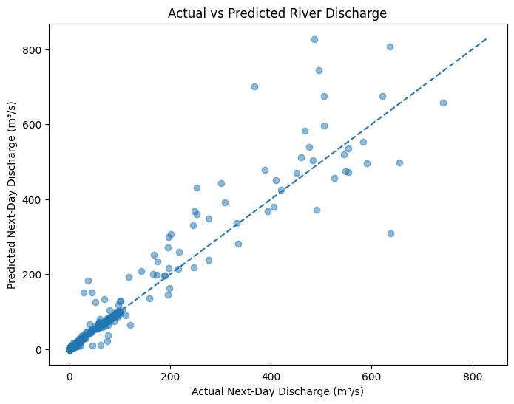
Accuracy on typical days and flood peaks
0.05
1.47
median error m³/s
90th percentile error
2.49
109.2
mean error (MAE)
MAE on the 10 largest days
Typical days are nearly perfect, but peak days average about 44× the overall error. Worst miss: 341.0 m³/s.

Slide 14
workflow : next-day weather class
Labels
Target
Models
Each day is Cold, Cool, Warm or Hot, compared with its own station's normal
Tomorrow's class, predicted from today's weather and recent temperatures
Logistic Regression, Decision Tree, Random Forest and the baseline
10,610
2,660
53
training rows
test rows (from 7 Dec 2025)
features (51 + 2 new)

Slide 15
Weather class results on the test set
Model | Accuracy | F1 (macro)
Baseline (tomorrow = today) | 0.850 | 0.834
Logistic Regression | 0.843 | 0.831
Decision Tree | 0.798 | 0.781
Random Forest | 0.824 | 0.810
Baseline = "tomorrow's class equals today's". Logistic Regression is the best of the three models, but the baseline is slightly higher.

Slide 16
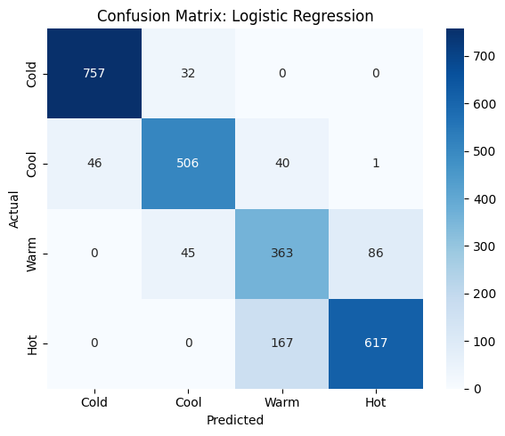
Where the best model goes wrong
Cold is easiest (96% correct) and Warm is hardest (73%).
Almost all mistakes are between neighbouring classes; Cold and Hot are never confused.
The biggest miss: 167 Hot days predicted as Warm.

Slide 17
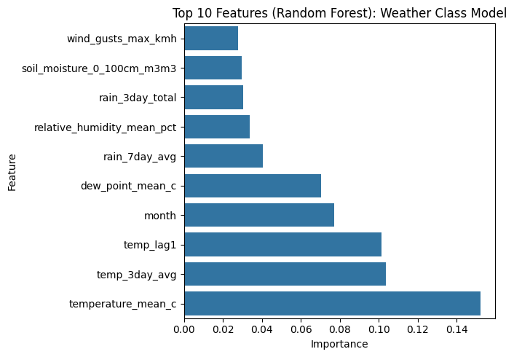
What drives tomorrow's weather class
Today's temperature matters most, then the 3-day average and yesterday's.
Month adds the seasonal pattern; rain, humidity and wind matter much less.
Next-day forecast (30 Aug 2026 data): all 10 stations stay in their current class.

Slide 18
Conclusion
Next-day river discharge can be predicted from weather, soil moisture and recent flow, with R² above 0.9.
Random Forest is the best model for discharge: MAE 2.49 m³/s, RMSE 17.39 m³/s, R² 0.913.
Next-day weather class (Cold, Cool, Warm, Hot) can also be predicted: Logistic Regression is best, with 84.3% accuracy and macro F1 0.831.
In both parts the "tomorrow = today" baseline is slightly better than every model (discharge MAE 1.97, R² 0.942; weather accuracy 85.0%).
Today's discharge holds about 82% of the discharge model's importance; for weather, today's temperature and the recent trend matter most.
Discharge errors are largest on extreme flood days: MAE 109.2 m³/s on the 10 highest days vs 2.49 overall.

Slide 19
THANK YOU

